Slide 1
What are some of the best ways to mitigate loneliness in the modern society?
By: Abhinn Kaushik, Xujia Shen, Yifan Qiu, Yongjun Du
*The names are listed in alphabetical order and do not reflect the extent of individual contributions.

Slide 2
Introduction
Loneliness has become an increasingly prominent issue in modern society, influencing individuals' mental health and quality of life. This research employs a multi-method approach to identify optimal solutions for alleviating loneliness. This aims to provide actionable recommendations to address loneliness in diverse societal contexts.
Notes:
Introduction
Loneliness has become an increasingly prominent issue in modern society, influencing individuals' mental health and quality of life. This research employs a multi-method approach to identify optimal solutions for alleviating loneliness. Hypothesis testing is used to evaluate the effects of specific factors—such as pet ownership, social interactions, and group sports—on reducing loneliness. Decision tree classification models are applied to categorize individuals as "lonely" or "not lonely" based on various attributes. Finally, a clustering approach is utilized to determine which intervention strategy proves most effective for different groups. This comprehensive analysis aims to provide actionable recommendations to address loneliness in diverse societal contexts.

Slide 3
Dependent variable: loneliness
Independent Variables: Own pets, Social interaction frequency, age
Step 1: What types of people tend to feel more lonely?
Dependent variable: loneliness, independent variables: age, immigration, gender,indigenous, etc. -> Find out what types of people tend to feel more lonelier BMW(example question: Do the elderly tend to feel more lonelier?)
Step 2: Do some of the *commonly-used* ways to counter loneliness actually work?
Dependent variable: loneliness, independent variables: pets, social interaction, exercises -> Goals: Find out whether certain methods work
Pets, exercise,
Step 3: What is the most effective method among all effective methods identified through question 2?

Slide 4
Data Summary
For Q1:
1. Handling Missing Values
Age (DEMO_age)& Gender(DEMO_gender) : Missing values were removed.
DEMO_identity_lgbtq and DEMO_identity_newcomer: For both of these categorical variables "Not selected" is recorded as “Not LGBTQ” and “Not Newcomers”
2. Creation of the Target Variable:
LONELY_ucla_loneliness_scale_score:
We transformed this continuous variable into a binary classification variable —— LONELY_status
Scores ranging from 3 to 5 ——"Not Lonely".
Scores ranging from 6 to 9 ——"Lonely".

Slide 5
For Q2&3
Dependent variables:
“GEO_housing_live_with_dogs” and “GEO_housing_live_with_cats”,
“CONNECTION_activities_talked_day_p3m”,
“CONNECTION_activities_group_exercise_p3m”
Independent variables: LONELY_ucla_loneliness_scale_score
First, we removed all of the missing values for our variables
Then we combined these columns GEO_housing_live_with_dogs and GEO_housing_live_with_cats and transformed this continuous variable into a binary classification variable.
If they had at least one cat or one dog, we recorded it as yes; otherwise, it was recorded as no in a new column called Pet_or_no.

Slide 6
What types of people tend to feel more lonely?
Analysis using decision tree

Slide 7
Goal: Identify people in need of help
Dependent Variable: Loneliness score
Independent Variable: DEMO_age, DEMO_gender
DEMO_identity_newcomers, DEMO_identity_lgbtq

Slide 8
Method: Decision Tree
Reasons

Slide 9
Variables we choose
UCLA Loneliness Scale Score: A widely used scale in studies of loneliness, developed by researchers at University of California, Los Angeles in 1978. It is the loneliness scale to achieve widespread acceptance among scientists.
Age: We would want to investigate what age group tend to feel more lonely?
Gender and LGBTQ Identity: Does identifying as LGBTQ affects one’s feeling of loneliness? Does gender have an impact on loneliness?
Immigration (Newcomer status): Newcomers tend to feel more lonely in a new environment. We want to evaluate whether this statement is true with the dataset.

Slide 10
The Approach
How we handle categorical data:
DEMO_gender: man - 0, non-binary-1, woman-2
DEMO_identity_newcomers: newcomers - 1, not selected and presented but no response - 0
DEMO_identity_lgbtq: not selected and no response - 0, lgbtq - 1
How we build up the model:
We split the data into a 70-30 train-test split.
We trained the model based on the 70% training dataset and tested it on the 30% test dataset.
Restricting a depth of 4 will reduce overfitting.

Slide 11
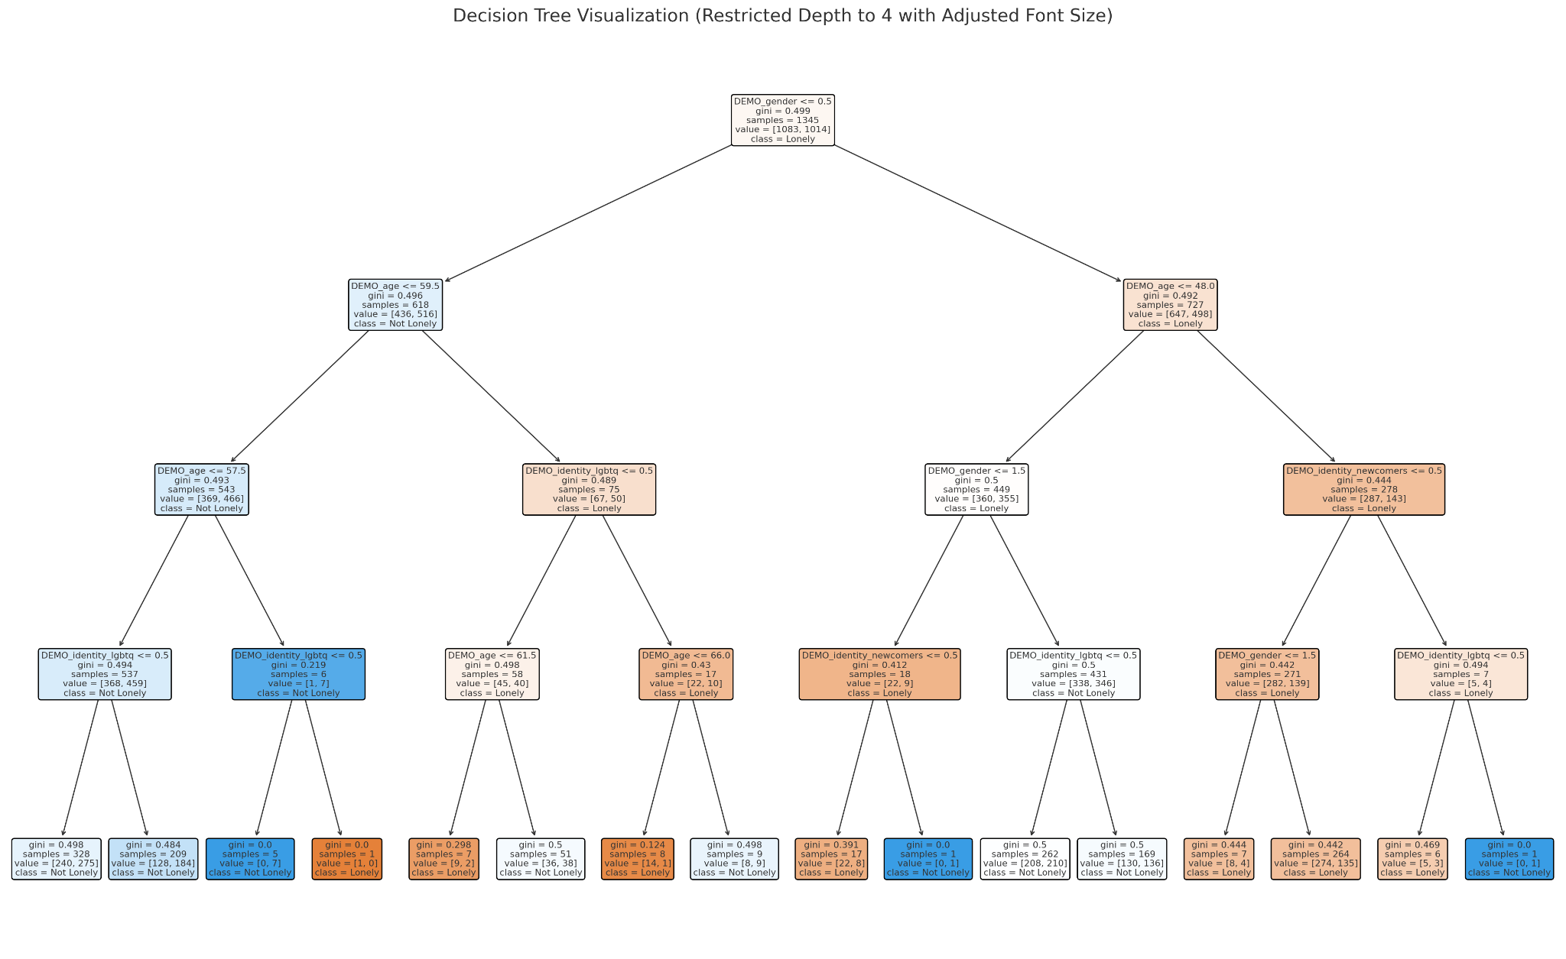
The Decision Tree

Slide 12
Results Analysis
Age: Younger and older age groups tend to feel more lonely
Gender and LGBTQ Identity: Gender alone has little effect on loneliness, while identifying as LGBTQ will increase likeliness of feeling lonely.
Newcomer status: We have proven that newcomer status will likely cause one to feel lonely.

Slide 13
Evaluation of the model and further thoughts
Overall accuracy of the model (out-of-sample):
Precision: 56%
Recall: 54%
F1-Score: 50%
Further thoughts:
Model improvements: Introducing additional variables will further enhance predictive power.
Social insights:
Focus on addressing the needs of newcomers and LGBTQ individuals, as they are more likely to experience loneliness.
Create age-specific interventions targeting social inclusion and mental health.

Slide 14
2. Do Commonly-Used Ways works?
Goals:
Investigate whether pets, exercise, and social interaction effectively reduce loneliness.
Dependent Variable: Loneliness (LONELY_ucla_loneliness_scale_score)
Independent Variables: Pet_or_no, CONNECTION_activities_talked_day_p3m,
CONNECTION_activities_group_exercise_p3m
Methods:
Use Hypothesis test (statistical tests (t-tests, bootstrapping) to compare loneliness scores between different groups for each independent variables.

Slide 15
Exercise Frequency & Loneliness
H₀: No significant difference in loneliness between high and low exercise frequency groups.
H₁: Significant difference in loneliness between high and low exercise frequency groups.
Method: Bootstrapping to compare loneliness scores.
Results: Low group mean: 5.59, High group mean: 5.30, p-value: 0.0003.
Conclusion: p-value < 0.05, reject the null hypothesis.
High exercise group’s loneliness is significantly lower than low exercise group’s.

Slide 16
Pets & Loneliness
H₀: No significant difference in loneliness between pet and non-pet groups.
H₁: Significant difference in loneliness between pet and non-pet groups.
Results:
Pet group mean: 5.43, No pet group mean: 5.66. p-value: 0.4989
Conclusion: Fail to reject the null hypothesis.

Slide 17
Social Interaction Frequency & Loneliness
H₀: No significant difference in loneliness between high and low social frequency groups.
H₁: Significant difference in loneliness between high and low social frequency groups.
Method:Using t-test to compare loneliness scores between the groups.
Results: Low group mean: 5.60, High group mean: 5.44.
t-statistic: 2.36, p-value: 0.0183.
Conclusion: p-value < 0.05, reject the null hypothesis.
High social frequency group’s loneliness is significantly lower than low frequency group’s

Slide 18
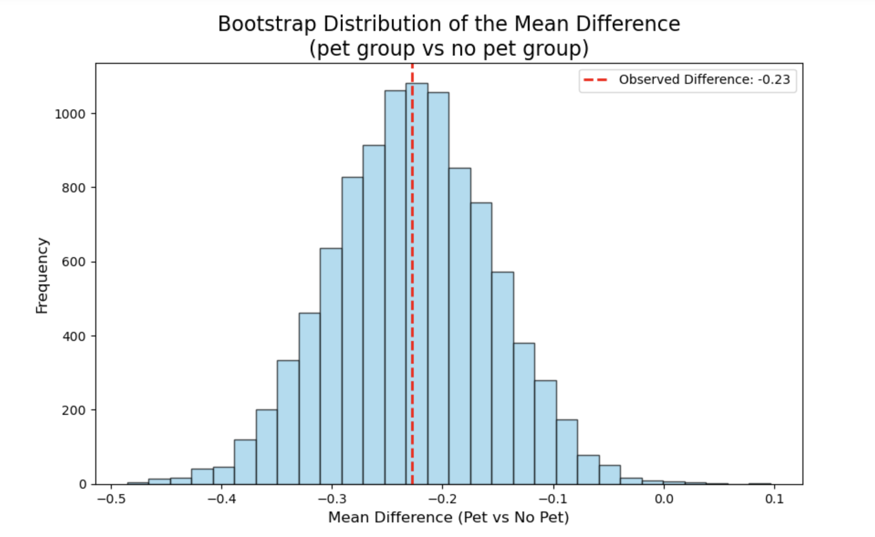
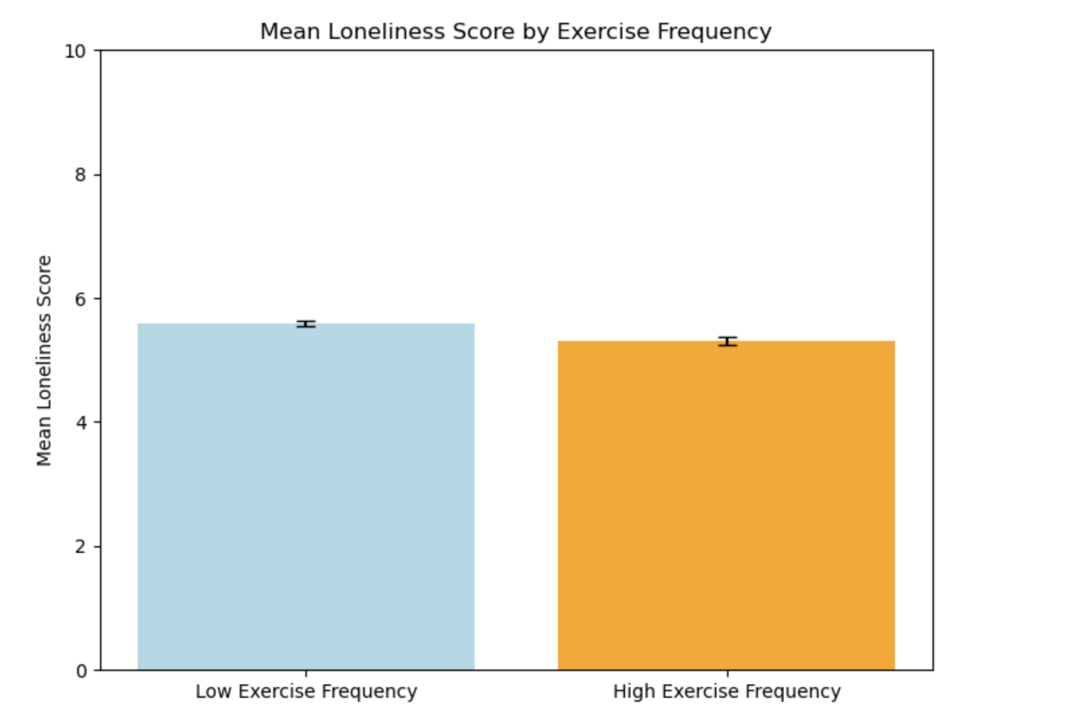
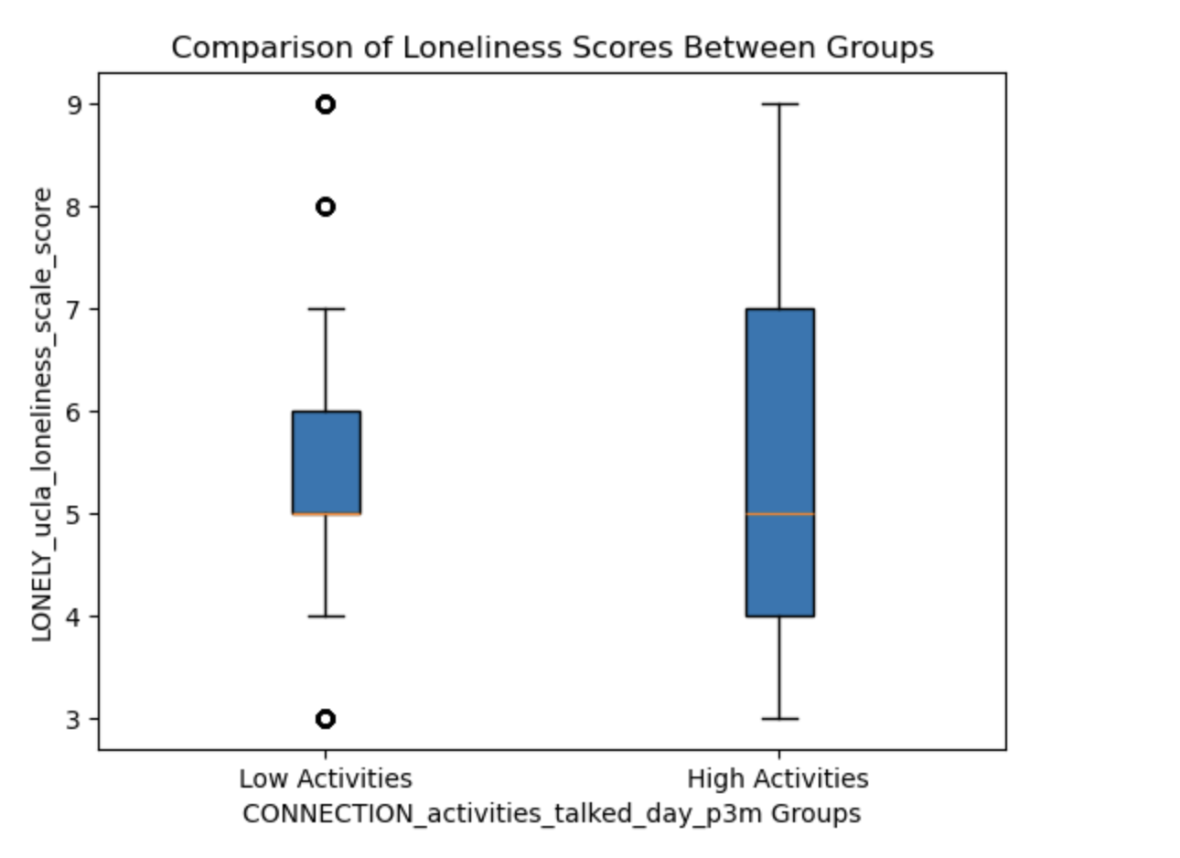

Slide 19
3. What is the most effective method among the methods we identified through question 2?
Key Variables:
Communication Frequency
Exercise Frequency
Goal: Use clustering to analyze which variable (talk or exercise) has the most significant impact on loneliness reduction

Slide 20
Clustering Approach and Methodology
Data Preparation
Categorized loneliness scores
Variables analyzed
Talk frequency (CONNECTION_activities_talked_day_p3m)
Exercise frequency (CONNECTION_activities_group_exercise_p3m)
Used PCA to reduce Dimensions
Clustering Method
Applied K-Means Clustering to group individuals based on:
Loneliness scores
Talk frequency
Exercise frequency
Determined optimal clusters visually and through mean analysis.

Slide 21
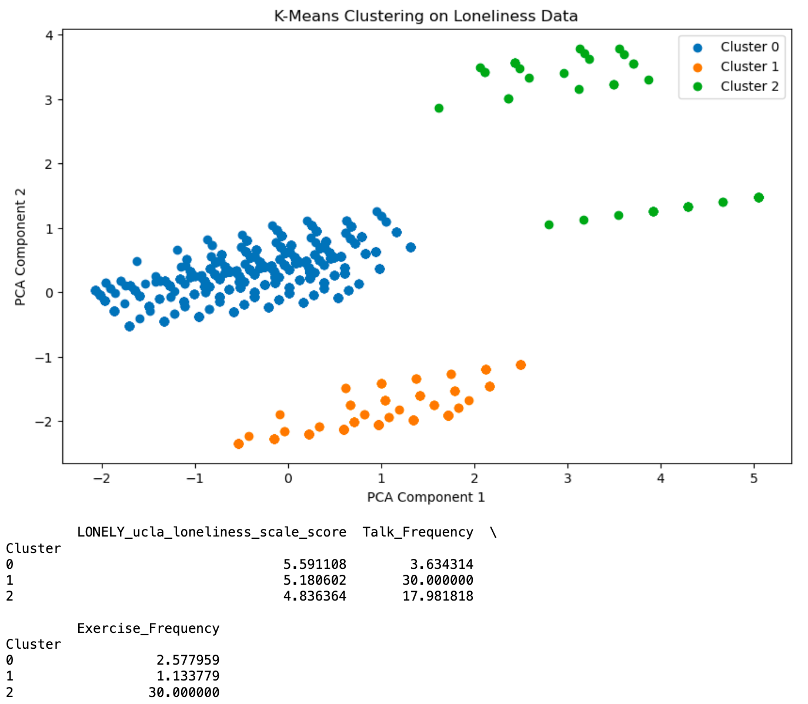
Clustering Results
Cluster 0
Moderate loneliness.
Moderate talk frequency and low exercise frequency.
Cluster 1
High loneliness.
Daily social interaction but very low exercise.
Cluster 2
Low loneliness.
High talk and exercise frequency.

Slide 22
Key Takeaways and Recommendations
Exercise is slightly more impactful than social interaction alone in reducing loneliness.
The combination of both high exercise and social interaction frequency results in the lowest loneliness scores.
Encourage interventions that promote both physical activity and regular social interaction.
Focus resources on combined methods rather than individual strategies

Slide 23
Overall Summary
Pets? Exercise, communication..?

Slide 24
Limitation:

Slide 25
Thanks for listening
Acknowledgements
Thank Prof Scott, Dr. Kiffer Card and Christine Ovcaric for creating and identifying this project for you... probabably our TUT TA Yu Shi and all our peers.

